Slide 1
Web Applications
A Web application is a system that utilizes W3C standards & technologies to deliver Web- specific resources to clients (typically) through a browser.
Examples
Search Engines Portals, Ecommerce websites, and all static to dynamic websites

Slide 2
Website vs web pages
A website, also written as web site, or simply site, is a set of related web pages typically served from a single web domain. Whereas
A web page is one single page of information, while a website is made up of a number of different web pages connected by links.

Slide 3
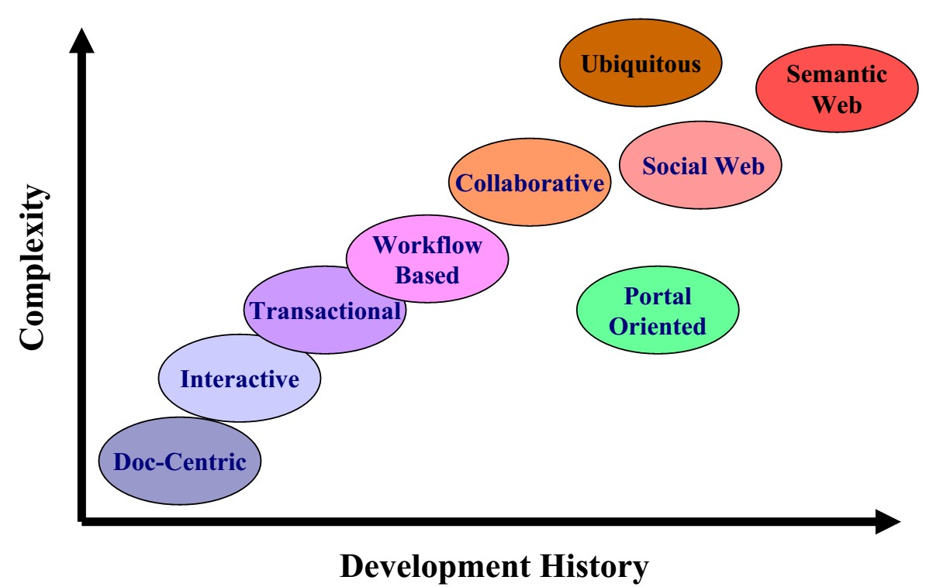
Categories of Web Applications

Slide 4
Document-Centric Web sites
Precursors to Web applications
„ Static HTML documents
Manual updates
„Pros
…Simple, stable, short response times
Cons
…High management costs for frequent updates & large collections
…More prone to inconsistent/redundant info
„ Example: static home pages

Slide 5
Interactive & Transactional
Come with the introduction of CGI and HTML forms
Simple interactivity
Dynamic page creation
Web pages and links to other pages generated dynamically based on user input
Content updates -> Transactions
Decentralized
Database connectivity
Increased complexity
Examples: news sites, booking systems, online banking

Slide 6
Workflow-Based Applications
Designed to handle business processes across departments, organizations & enterprises
Business logic defines the structure
The role of Web services
Interoperability
Loosely-coupled
Standards-based
Examples: B2B & e-Government
High complexity; autonomous entities

Slide 7
Collaborative & Social Web
Unstructured, cooperative environments
Support shared information workspaces to create, edit and manage shared information
Interpersonal communication is paramount
Classic example: Wikis
The Social Web
Anonymity traditionally characterized WWW
Moving towards communities of interest
Examples: Blogs, collaborative filtering systems, social bookmarking(e.g., delicious.com)
Integration with other forms of web applications (e.g., NetFlix

Slide 8
Portal-Oriented
Single points-of-entry to heterogeneous information
Yahoo!, AOL.com, portal.kfupm.edu.sa
Specialized portals
Business portals (e.g., employee intranet)
Marketplace portals (horizontal & vertical)
Community portals (targeted groups)

Slide 9
Ubiquitous
Customized services delivered anywhere via multiple devices
HCI is critical
Limitations of devices (screen size, bandwidth?)
Context of use
Still an emerging field; most devices have single focus:
Personalization
Location-aware
Multi-platform delivery

Slide 10
Semantic Web
Berners-Lee: Information on the Web should be readable to machines, as well as humans.
Using metadata and ontologies to facilitate knowledge management across the WWW.
Content syndication (RSS, Atom) promotes reuse of knowledge
Is the Semantic Web even possible?

Slide 11
Characteristics of Web Apps
How do Web applications differ from traditional applications?
Or, another way, what Software Engineering methods & techniques can be adapted to Web Engineering?
3 dimensions of the ISO/IEC 9126-1 standard
Product
Usage
Development

Slide 12
Characteristics -Product
Product-related characteristics constitute the “building blocks” of a Web application
Content
Document character & multimedia (# of dimensions?)
Quality demands: current, exact, consistent, reliable
Navigation Structure (Hypertext)
Non-linearity
Potential problems: Disorientation & cognitive overload
User interface (Presentation)
Aesthetics
Self-explanation

Slide 13
Characteristics -Usage
Much greater diversity compared to traditional non-Web applications
Users vary in numbers, cultural background, devices, h/w, s/w, location etc
Social Context (Users) Social Context (Users)
Spontaneity -scalability
Heterogeneous groups
Technical Context (Network & Devices)
Quality-of-Service
Multi-platform delivery
Natural Context (Place & Time)
Globality
Availability

Slide 14
Characteristics -Development
The Development Team
Multidisciplinary –print publishing, s/w devt, marketing &
computing, art & technology
Community (including Open Source)
Technical Infrastructure
Lack of control on the client side
Immaturity
Process
Flexibility
Parallelism
Integration
Internal –with existing legacy systems
External –with Web services
Integration issues: correct interaction, guaranteed QoS

Slide 15
eSystem
Examples Includes
– telecommunication systems, computer systems, power distribution
systems, radar systems, electronic music systems, and many others.

Slide 16
eCommerce Systems
is a type of industry where the buying and selling of products or services is conducted over electronic systems such as the Internet and other computer networks.
E-commerce can be divided into:
E-tailing or "virtual storefronts" on websites with online catalogs,
sometimes gathered into a "virtual mall"
Buying or Selling on various websites and/or online marketplaces
The gathering and use of demographic data through Web contacts and
social media
Electronic Data Interchange (EDI), the business-to-business exchange of data
E-mail and fax and their use as media for reaching prospective and established customers (for example, with newsletters)
Business-to-business buying and selling
The security of business transactions

Slide 17
eGOV systems
‘The employment of the Internet and the world-wide-web for delivering government information and services to the citizens.’
e-Government delivery models can be briefly summed up as (Jeong, 2007):
G2C (Government to Citizens)
G2B (Government to Businesses)
G2E (Government to Employees)
G2G (Government to Governments)
C2G (Citizens to Governments)

